Slide 1
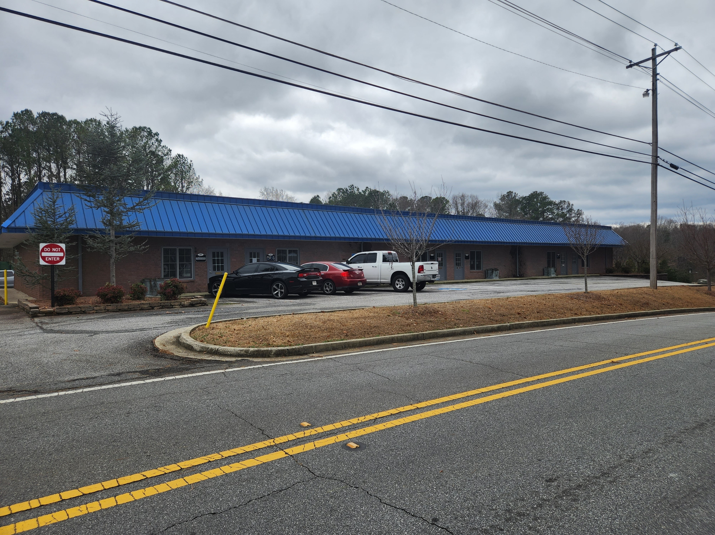
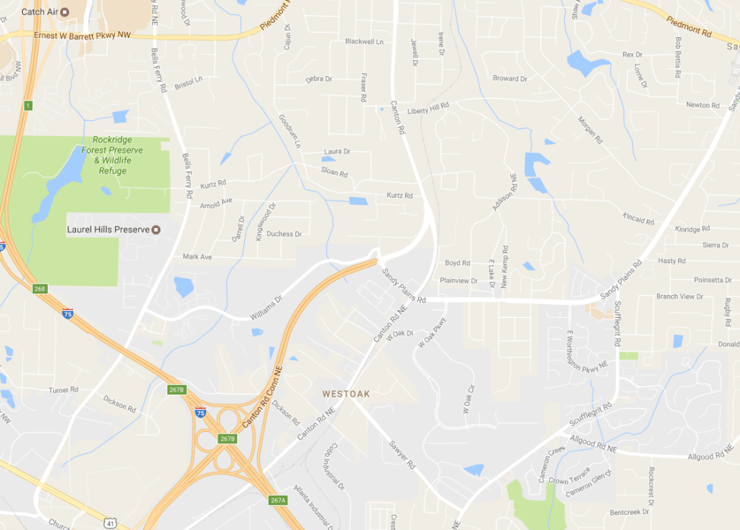

FOR LEASE
Office Warehouse (Flex)
1,100 SF
878 Kurtz Road, Suite 103
Marietta, GA 30066
Office Entrance
Office
Warehouse
PROPERTY HIGHLIGHTS
Suite 103 - Available October 23, 2023
1,100 SF Warehouse/Flex Space
Rate: $1,600.00 per Month/ $17.45 PSF. Includes Base Rent, NNN’s and HVAC Maintenance Fee.
Monthly Rent includes Center Maintenance, Water and Use of Dumpster. Electricity and Internet are Responsibility of Tenant.
Perfect for contractor, wholesaler, or a small office user that needs conditioned and unconditioned storage space.
Office has new carpet and freshly painted walls, and the warehouse has freshly painted walls and floor, with ceiling tiles throughout.
100 AMP electrical service
Single Interior Bathroom
Parking for 2 office vehicles & maximum 2 vehicles extra parking behind units.
For More Information contact:
Jeff McMullen
(770) 380-6538 - Mobile
(404) 816-1600 ext. 145 Office
jmcmullen@richardbowers.com

Slide 2
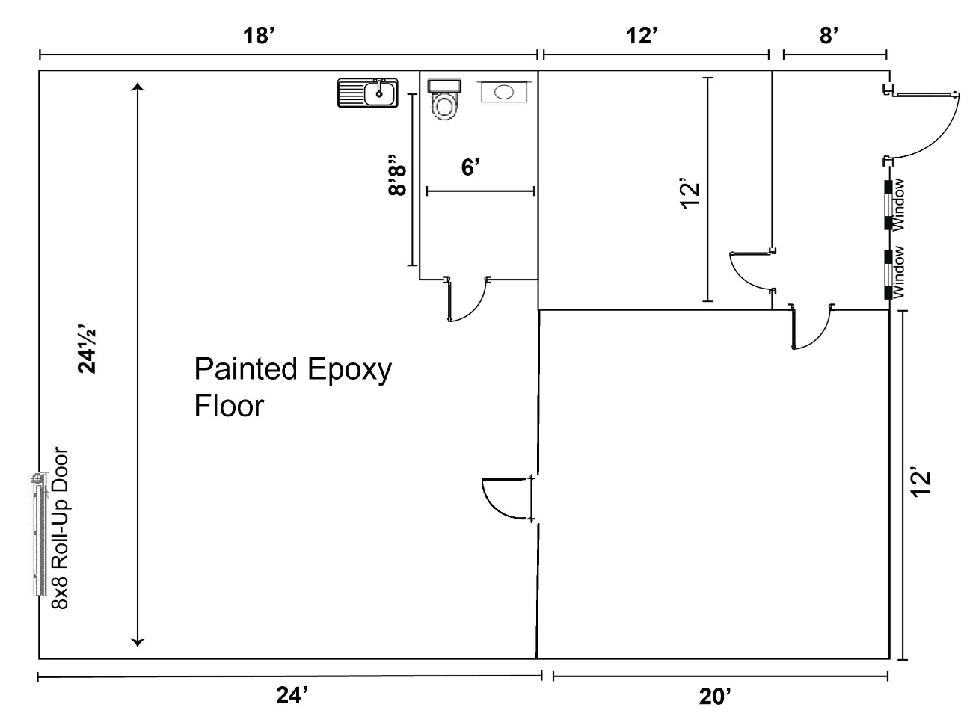
FOR LEASE
Office Warehouse (Flex)
1,100 SF
878 Kurtz Road, Suite 103
Marietta, GA 30066
Floor Plan- Suite 103- 1,100 SF
Approximate Measurements
For More Information contact:
Jeff McMullen
(770) 380-6538 - Mobile
(404) 816-1600 ext. 145 Office
jmcmullen@richardbowers.com

